Slide 1
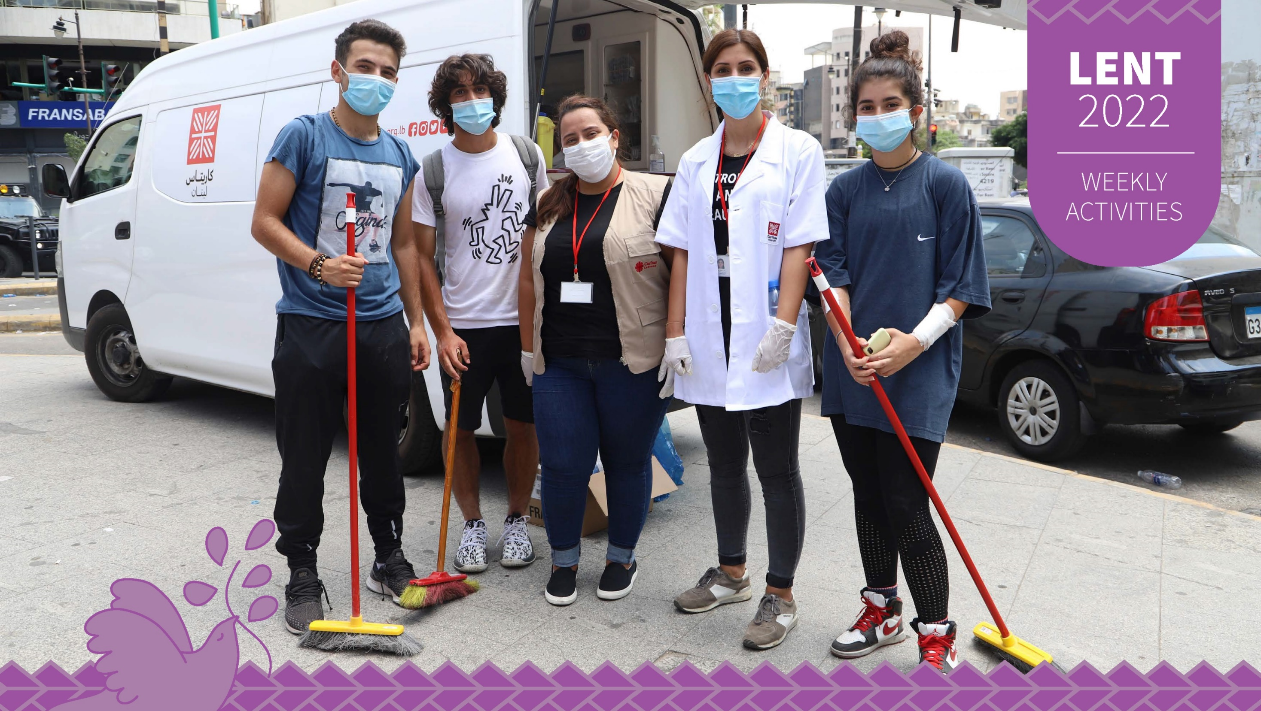


Slide 2


















Slide 3

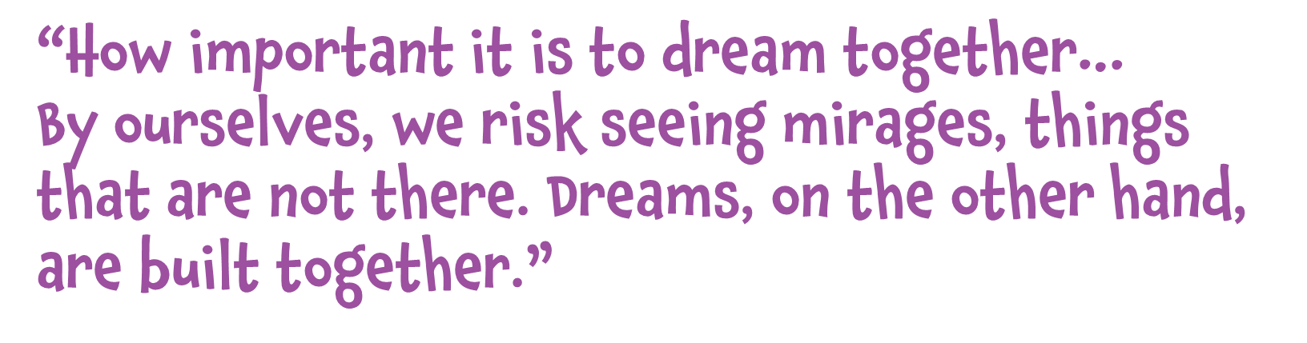
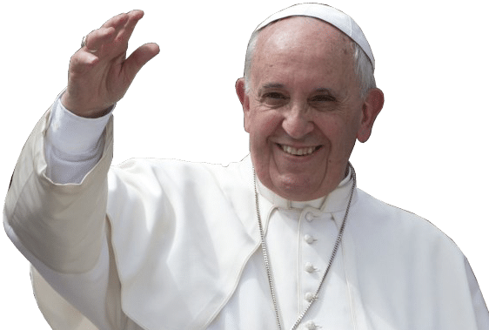
Notes:
Image credit: Flickr

Slide 4



E Hehu Karaiti, Lord Jesus, guide us this day as we begin this season of Lent. May your Spirit lead us now as you were led in the desert for forty days.
Help us to overcome the challenges we face in our lives. Help us also to dream of something better and bring peace, light and hope into the world. We make this prayer
through Christ our Lord. Amene.

Slide 5



As Lent begins we draw closer to God and remember Jesus’ sacrifice on the cross and his love for others. We are challenged to put others before ourselves and dream for a better world. It is through simple acts of love by individuals (starting with us) that can transform our world for the better.

Slide 6

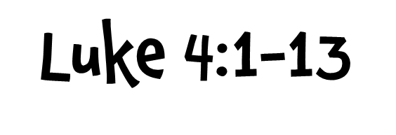
Read the full Gospel reading by clicking here
Summary:
• Jesus is led by the Spirit into the wilderness where he is tempted by the devil for 40 days.
• During this time he did not eat anything.
• The devil tries to tempt Jesus to change a stone into bread.
• Jesus recites scripture saying, ‘One does not live on bread alone’.
• Again the devil tempts Jesus offering him all the kingdoms of the world if he will worship him.
• Jesus again quotes Scripture saying, ‘Worship the Lord your God, and serve only him.’
• The devil tempts Jesus a third time challenging him to prove he is the Son of God by throwing himself on the pinnacle of the temple.
• Jesus refuses saying, ‘Do not put the Lord your God to the test.’
• The devil departed from Jesus when he had finished all the tests.

Slide 7


Caritas supports Lujan Home for Girls in Vanimo, Papua New Guinea. This refuge home run by the SSVM Sisters look after around 30 girls as young as two years old. They operate the Home like a family caring for the girls like they are their own. Security and food are two of the largest expenses which Caritas supports. Malnutrition is a significant issue in Papua New Guinea, so the Home aims to not only provide the girls with nutritionally balanced and varied diets, but also to teach the girls about nutrition and cooking so that they can bring these skills back to their families and communities when they leave the Home.
Check out recent images from Lujan Home on the following slides.

Slide 8
Notes:
Image Credit: Lujan Home

Slide 9
Notes:
Image Credit: Lujan Home

Slide 10
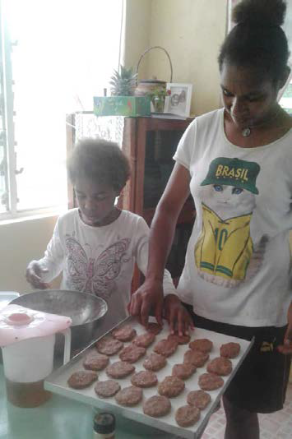
What stands out in these images?
Notes:
Image Credit: Lujan Home

Slide 11

It is hard to imagine how hard it must have been for Jesus to stay
strong for such a long time out in the wilderness. He showed great
strength and faith to overcome the devil. He was aware of something
better to come. Jesus, himself, would change the world for the good
of all.
Many of the girls living in Lujan Home have experienced some very
hard challenges and have shown great strength and resilience. The
Lujan Home runs on the providence of God, meaning that they run
their organisation trusting that God will provide. In spite of the worry
that food and funding will run out they have continued to dream of
a life that is better for the girls. Their strength and faith remind us all
to trust in God’s will in every circumstance.

Slide 12


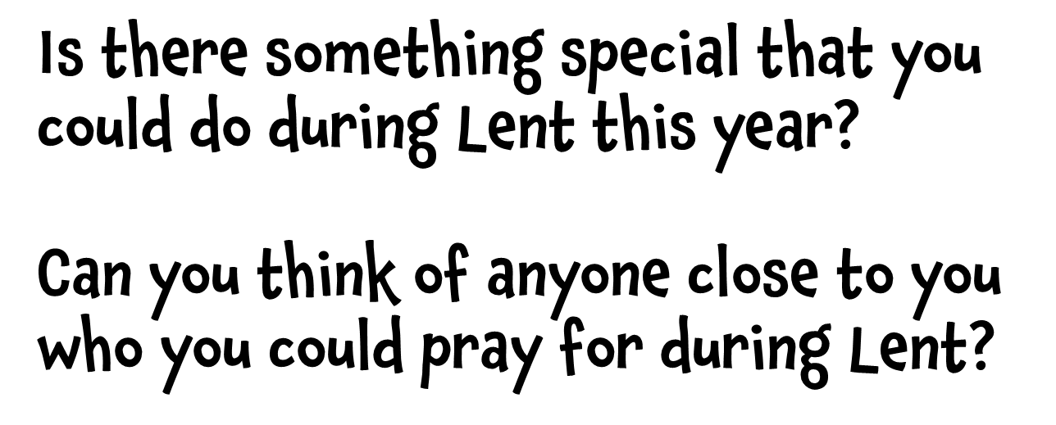

Slide 13


Have a class discussion about your best dreams. Who has had the weirdest dream? Close your eyes and try to imagine/dream of something good happening this month. Share with others what you saw. Draw a picture of your chosen dream and display this for others to enjoy.
Watch this short PowerPoint story about Marijo – one of the girls at Lujan Home for Girls who has had her life transformed and is now making her dreams for something better come true as part of the Queen of Paradise Orchestra in Papua New Guinea.
Watch Marijo and the Queen of Paradise Orchestra PowerPoint

Slide 14


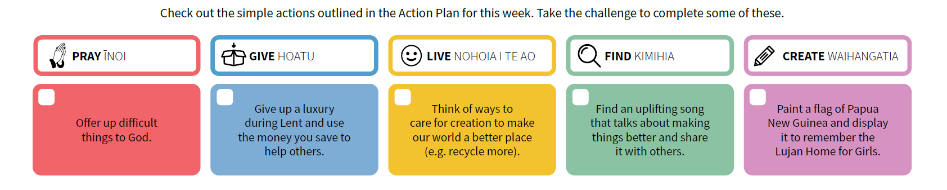


Slide 15

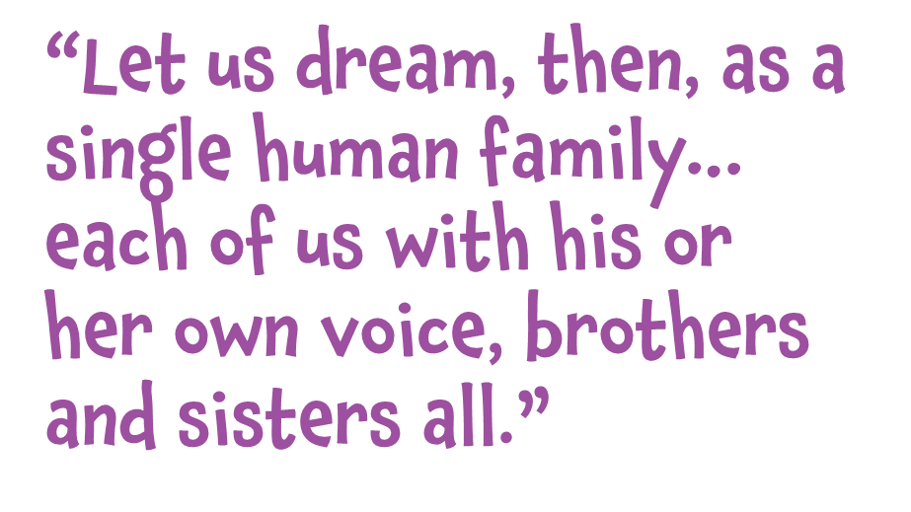
Notes:
Image credit: Flickr

Slide 16

E te Atua, God of encounter, awaken us to your living presence within us. May we hear your voice within the Scriptures as they show us your perfect will. Help us to see others through your eyes and to work with them to bring peace, hope and light into the world. May your will be done. Amene.

Slide 17

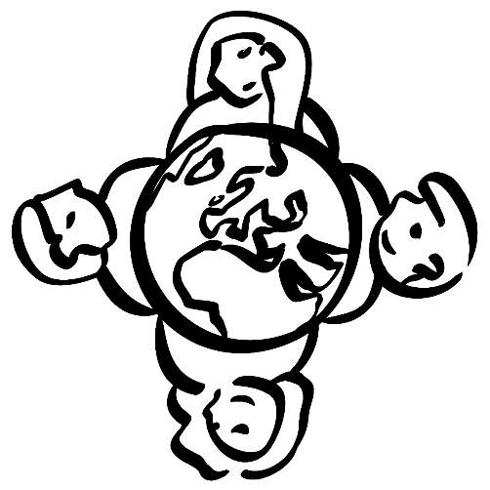
Pope Francis wrote a letter to everyone in 2020 called Fratelli Tutti, reminding us that we are part of one human family and need to care for one another.
As we continue on our Lenten journey let’s keep putting others first and think of ways we can be better by working together.

Slide 18

Read the full Gospel reading by clicking here
Summary:
• Jesus took Peter, James and John and went up a mountain to pray.
• While he was praying, Jesus became dazzling white.
• Moses and Elijah appeared and were talking to Jesus.
• They too appeared in glory and were discussing Jesus’ departure.
• Peter and the others were tired but saw all that took place.
• Peter without thinking called out to Jesus offering to make three dwellings for Jesus, Moses and Elijah.
• A cloud appeared and enveloped them terrifying the three disciples.
• A voice was heard within the cloud saying, “This is my Son, my Chosen; listen to him!”
• Jesus was then found alone.
• The disciples never told anyone what happened.

Slide 19

At the Tutu Rural Training Centre (TRTC) in Fiji, young men and women are being transformed. Training courses are provided at Tutu, to help learners develop the spiritual, intellectual and physical aspects of their life and make a positive impact in their community.
Teachers work together with the young men and women to fulfil their talents and potential and help them make the most of their opportunities. Young farmers learn skills in agriculture and become confident leaders in their villages. The single women’s course helps the students to discover their natural talents and use them in small-business opportunities involving farming, textiles, handicrafts and cooking.

Slide 20
2021 was a hard year in Fiji due to the pandemic. Midway through the year, there was a sharp surge in COVID cases.
Notes:
Image credit: SEEP and Radio New Zealand

Slide 21
Cyclone Yasa and Ana caused problems throughout Fiji in December 2020 and January 2021.
Notes:
Image credit: Caritas Fiji

Slide 22
Young men and women at Tutu Rural Training Centre develop their skills for their future.
Notes:
Image credit: Tutu Rural Training Centre

Slide 23
Jesus was transformed on the mountain and this surprised his disciples and they saw him for who he really was.
Students at the Rural Training Centre are also transformed and are supported by others to find out more about themselves too. It is with the help of teachers and their peers that they find opportunities for the future.
Moses and Elijah were present with Jesus to confirm what was to come
and what Jesus was to carry out. Sometimes we need those around us
to provide guidance and confirmation of where we are going.
Fiji has had a tough time lately with cyclones and the impacts of the pandemic. However, the people have been strong and resilient and shown, in places like Tutu, that they can still work together for a positive future.

Slide 24
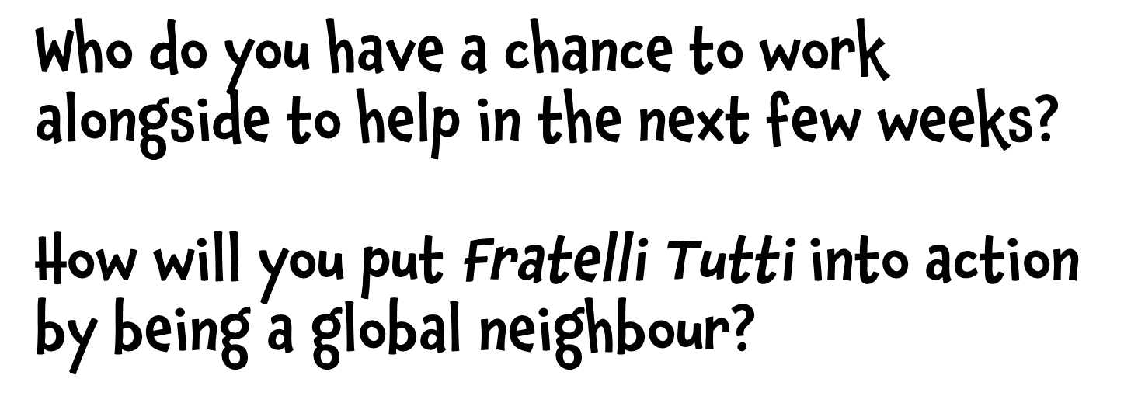

Slide 25

Like the students in Fiji, you are all very lucky to have teachers that help you to develop your skills in school.
What is one thing you have learnt to do because of your teacher(s)?
Make a thank you card for your teacher to let them know you value their help and the effort they make.
Notes:
Image credit: www.zazzle.co.nz

Slide 26

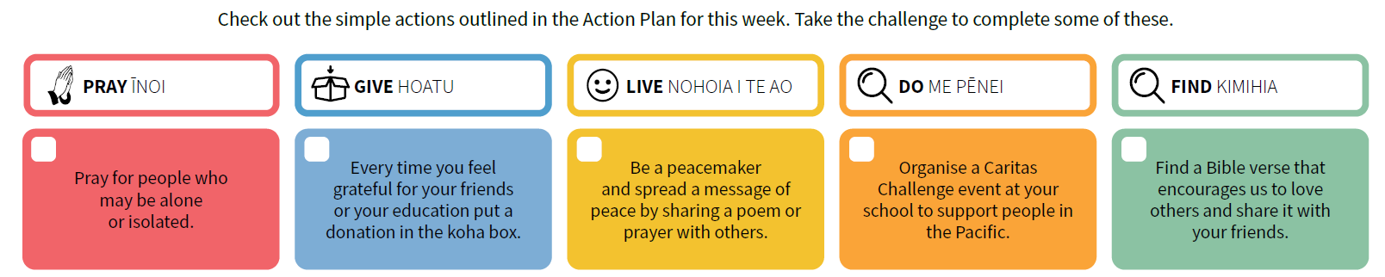




Slide 27

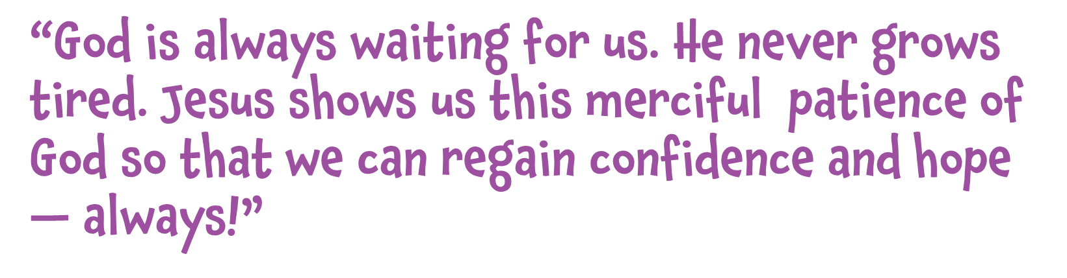
Notes:
Image credit: Flickr

Slide 28
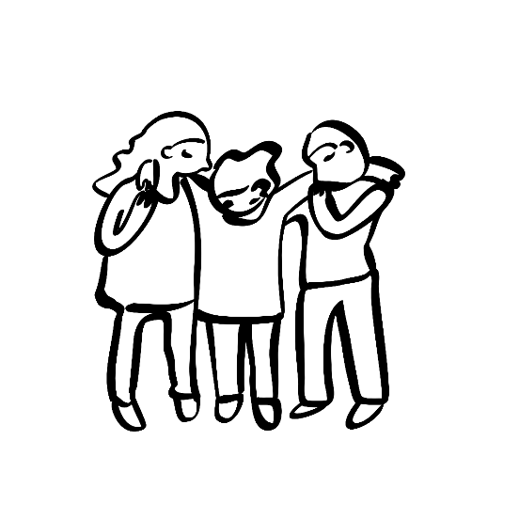
God of peace and hope, we pray for those in the Holy Land whose lives have been turned upside down by conflict. We remember especially those who are grieving, the injured and those without food, shelter or medical supplies.
We pray also for those who have the power to bring peace. May they be touched by a spirit of compassion and kindness. Lord hear us.
Amene.
(Adapted from a CAFOD prayer)

Slide 29


When things are bad, it is easy to lose hope. We can be drawn to the difficulties and feel like there is no way out. It is important to focus on what we have and what can be achieved with God’s help.
Sometimes time and changing circumstances provide a fresh perspective.

Slide 30
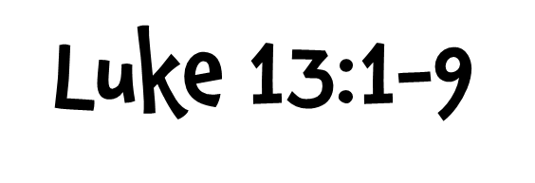
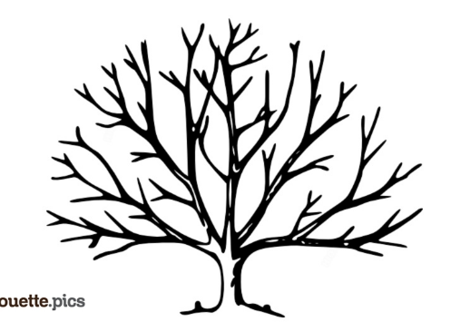
Read the full Gospel reading by clicking here
Summary:
• Jesus is told about Galileans who were killed by Pilate.
• Jesus asks whether they think that because the Galileans suffered that they were any worse than others.
• He reminds them about the importance of repentance.
• After mentioning an accident that happened in Jerusalem with a tower killing 18 people, he repeats the message, “unless you repent, you will all perish just as they did.”
• Then he tells the parable of the barren fig tree.
• A man looks for fruit from a fig tree that was planted on his vineyard.
• It has produced no fruit in the last three years so he asks the gardener to cut it down as it is wasting the soil.
• The gardener requests that the man waits one more year before he cuts it down and promises to give it attention and care (putting manure on it).

Slide 31

Conflict has caused many problems in the Holy Land for a long time. The majority of the population living in the West Bank and along the Gaza strip are living below the poverty line and are dependent on international aid. Caritas Jerusalem has two healthcare centres in the West Bank providing healthcare and education to children and families.
In the recent conflict, Caritas Jerusalem again used mobile medical units to bring critical health services to thousands of people where they lived. Youth groups and farmers have also been supported in different ways to help alleviate poverty.

Slide 32

Life has been tough in the Holy Land with ongoing conflict,
challenges due to the pandemic, and general health issues.
Watch an amazing example of the Caritas Jerusalem team caring for a family during the pandemic.

Slide 33
Local doctors and nurses spend their days helping out
children in the mobile health clinics.
Notes:
Image credit: Julianne Hickey / Caritas Aotearoa New Zealand

Slide 34
Local people from a refugee camp wait their turn to get the free medical healthcare provided by Caritas Jerusalem in Gaza.
Notes:
Image credit: Asmaa El Khaldi / Caritas Internationalis

Slide 35
The Gospel reading calls us not to focus on who has done wrong or who has done worse wrongs. Rather, it reminds us to repent and follow God.
Caritas Jerusalem’s focus is not on determining who is at fault but rather on providing care to those affected – mainly the poor and marginalised.
At first glance, the parable of the fig tree does not appear to have a profound message. However, in the context of the situation in the Holy Land, where many fig trees grow, it is perhaps more profound. Amidst despair, there is always hope – especially with God’s presence and help. Caritas Jerusalem has adaptively responded over the past 20 years to changing circumstances. With God’s help, and the patience of so many, they have shown that fruit can come from even the most unpromising things.

Slide 36
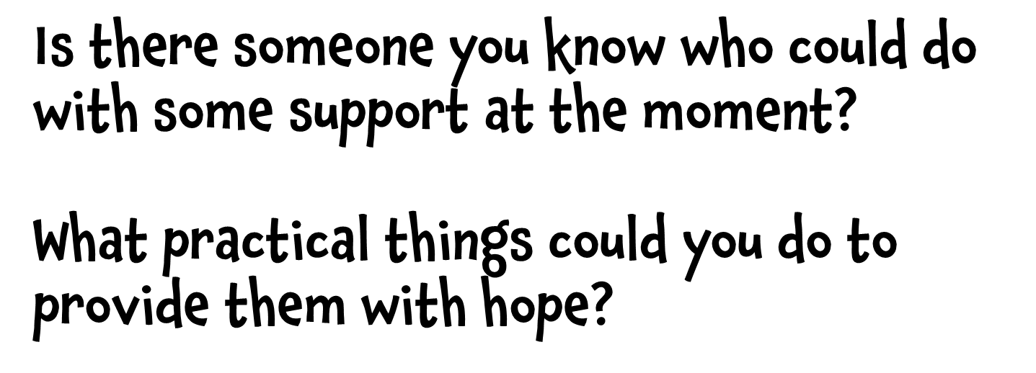

Slide 37
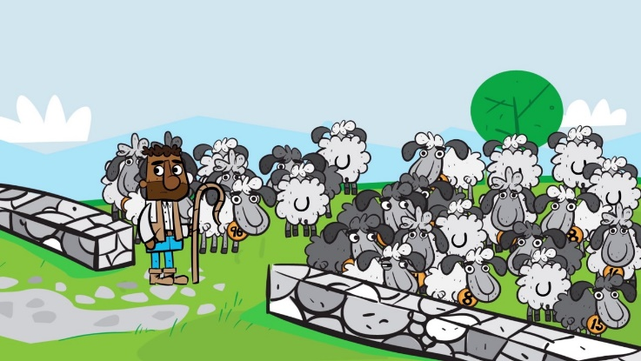
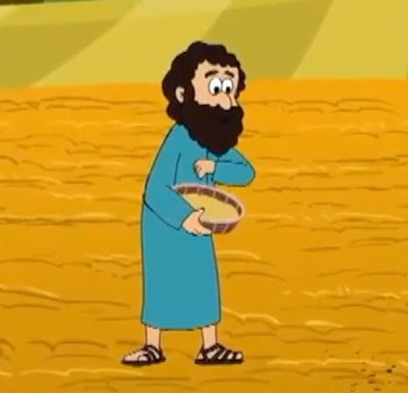
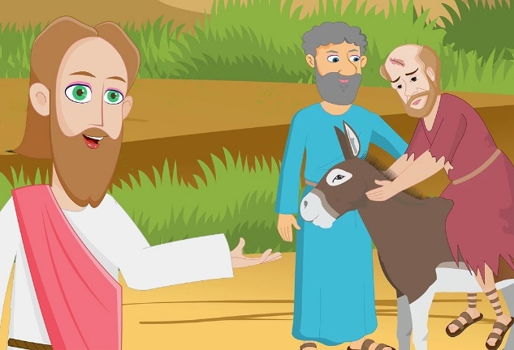
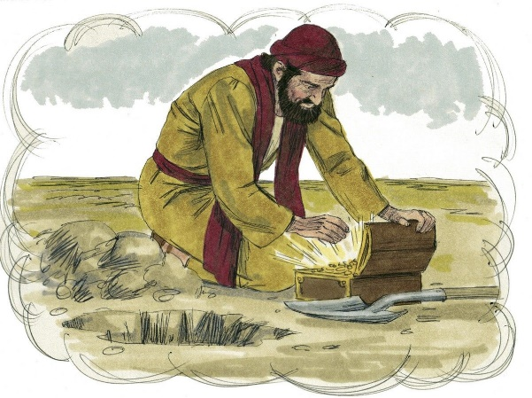
Choose another one of Jesus’ parables for your teacher to read to the class.
In small groups act out this parable and try to work out the message that Jesus was sharing.
Notes:
Image credit: Youtube

Slide 38
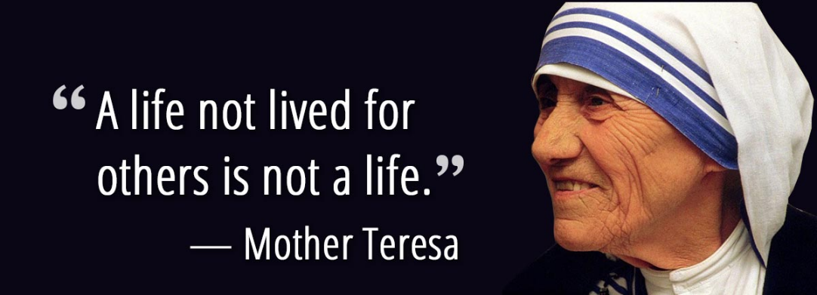
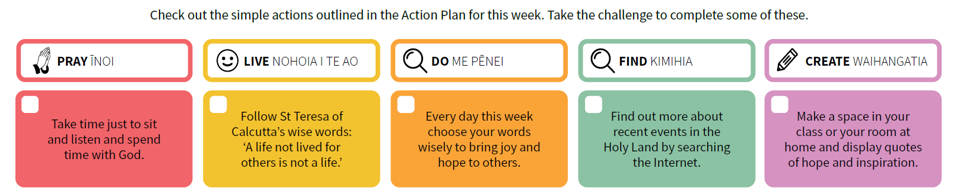


Slide 39

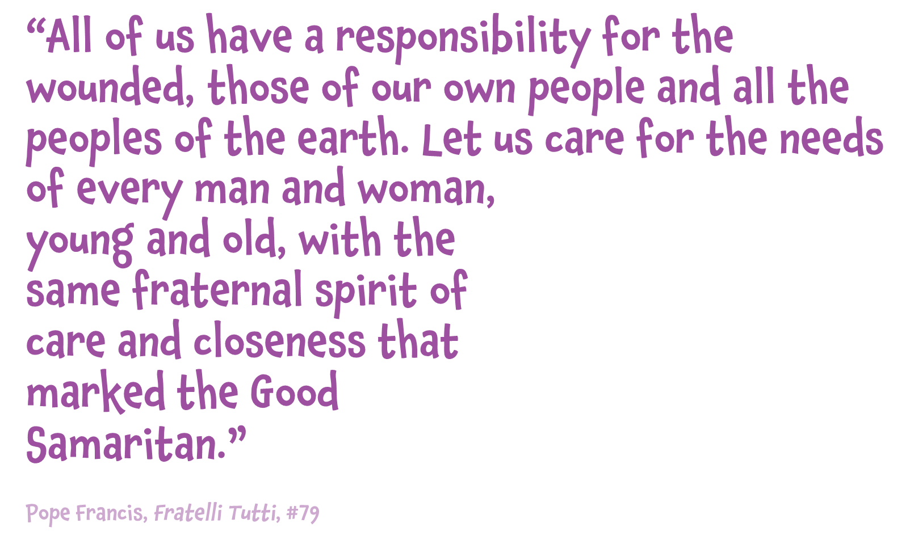
Notes:
Image credit: Flickr

Slide 40

E te Atua o te manaakitanga, God of hospitality, at times we wander from you, and you call us home. You always rejoice in those who are lost but now are found. Open our hearts to those who are making a fresh start.
God of hospitality, inspire us all to act with
kindness to welcome families and individuals who are starting again in our local community or even on the other side of the world. May your love abound. Amene.

Slide 41

Sometimes we face a situation where we are forced to make a fresh start. This can provide new opportunities but is often difficult as well.
As we continue on our Lenten journey, let’s turn our attention to those who have had to start again.

Slide 42

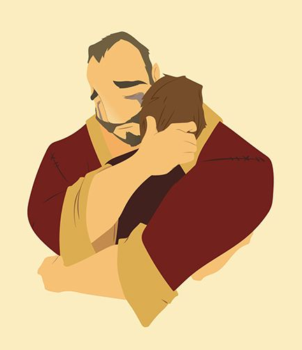
Read the full Gospel reading by clicking here
Summary:
• Tax collectors and sinners were coming to listen to Jesus and the Pharisees were complaining that Jesus was dealing with people like them.
• Jesus told them the Parable of the Prodigal Son.
• A man had two sons.
• The youngest son asked for his share of the inheritance so his father gave this to him. Soon after, the son left for a distant land and spent all of this money. He found himself without anything during a famine and was feeding pigs. He realised he needed to return to his father and say sorry and ask if he would have him back.
• The father ran to meet him and asked his slaves to provide him with clothes and to prepare a feast using the fatted calf as his son was ‘alive again’ and ‘found’.
• The eldest son heard the celebrating and found out that it was for his brother. He was angry and refused to join in. He pointed out to his father that he had never done the same for him even after his endless obedience and service.
• The father explained that his eldest son had always been with him but his brother was lost and now
found, dead and now back to life, so they had to celebrate.
Notes:
Image Credit: Blog.bible

Slide 43

The global Caritas network consisting of 165 Caritas agencies stretches to every country on our planet. In fact, Caritas is the second largest humanitarian network in the world. Every year, we witness emergencies on a large scale and the Caritas network responds to all of these to meet the needs of those most affected, working with them to ensure a fresh start.
The photos on the next slides provide examples of where and how Caritas responded to emergencies in 2021. This included the pandemic response in India, landslides and flooding in Indonesia, the earthquake in Haiti, unrest in Afghanistan and ongoing needs in Bangladesh.

Slide 44

Caritas Indonesia responded to massive flooding and landslides caused by Cyclone Seroja. The disaster damaged or destroyed thousands of homes and forced many people to take refuge in evacuation centres. Catholic youth volunteers helped Caritas distribute items and clear debris and mud from people’s homes. More than 181 people were confirmed dead, 12,344 were displaced, 47 were missing and 258 injured from the flash floods and cyclone which hit the East Nusa Tenggara islands on the 4th of April last year. 66,509 houses were affected during the flash floods and whirlwind.
Notes:
Credit: Caritas Indonesia/ Caritas Atambua

Slide 45

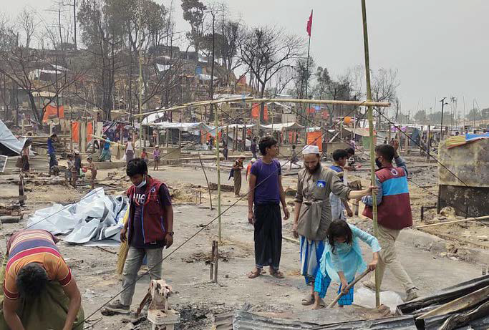
Caritas Bangladesh responded to a widespread fire in a Rohingya camp. Emergency teams on the ground were able to re-build shelters and provide cash support. The fire left 45,000 homeless and over 120,000 in desperate need of sanitation. This disaster was the latest trauma to affect the Rohinyga population, one million of whom fled persecution in their homeland in Myanmar. Then terrible flooding
impacted four hundred villages in Cox’s Bazar later in 2021 and families were again left shelterless as everything was submerged. Food and clean water were needed.
Notes:
Credit: Caritas Bangladesh

Slide 46

Caritas India appealed for global solidarity to help them respond to a second wave of the COVID-19 pandemic which was ravaging the country. A record 300,000-plus daily infections were being recorded in India in 2021 and oxygen and medical supplies were running low and the healthcare system was challenged. Caritas India has been supporting communities throughout the pandemic. It mobilised staff and volunteers to operate a COVID information centre and offer food, primary healthcare and medical support, including oximeters and inhalers, in response to the current second wave.
Notes:
Credit: Caritas India

Slide 47

Haiti experienced a devastating
earthquake on 14 August 2021
(7.2 on the Richter scale). Many
were affected and basic needs like food, water, tents, hygiene kits and
first aid were provided by Caritas
Haiti in immediate response.
Notes:
Credit: Caritas Internationalis

Slide 48

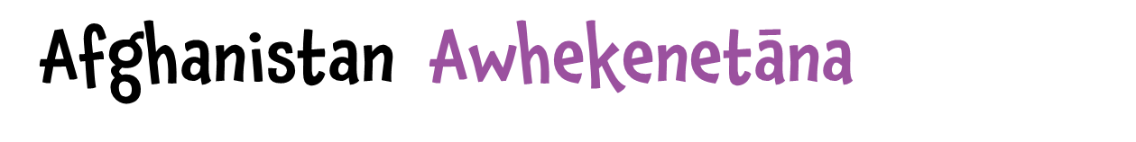
As a result of the Taliban's seizure
of power in Afghanistan, thousands
of refugees fled to neighbouring
countries, including Pakistan, and
there was an increasing need for
humanitarian assistance. Caritas
Pakistan provided food (dry rations),
kitchen sets, bedding sets, shelter
and hygiene kits.
Notes:
Credit: Catholic Relief Services

Slide 49
In the Gospel reading, we discover a father who is full of compassion
regardless of what the younger son has done. He celebrates the fact
that his son is now both found and alive again. His love and care are
instrumental in providing his son a fresh start and another go at life.
The father we read about in the Parable of the Prodigal Son has the
same qualities as our father in heaven. God is both loving and willing
to help us start again.
Millions of people around the world have been forced to start again
due to disasters and emergencies they have experienced. Caritas, as
love in action, plays a key role in enabling these communities to begin
again by walking with them in solidarity at the hardest point in their
lives when they have lost everything.
Notes:
Image Credit: Blog.bible and Caritas India

Slide 50
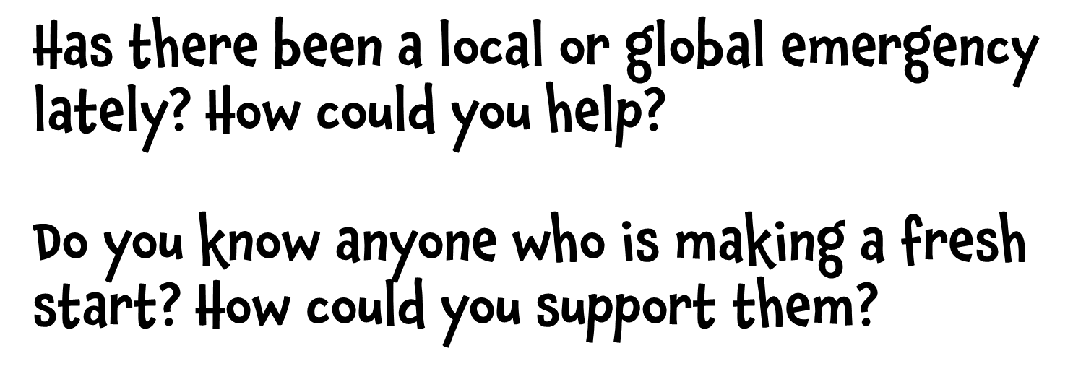

Slide 51
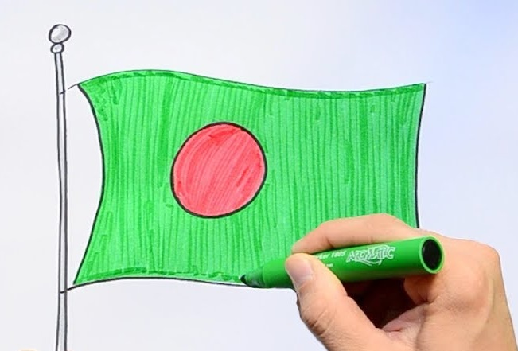
As a class, create country flags of the places around the world that have been impacted by disasters/emergencies recently.
Find the flags first and then draw and colour larger versions on posters.
Display these flags on your classroom wall and use them as a prayer focus as we remember families affected and their fresh starts.

Slide 52
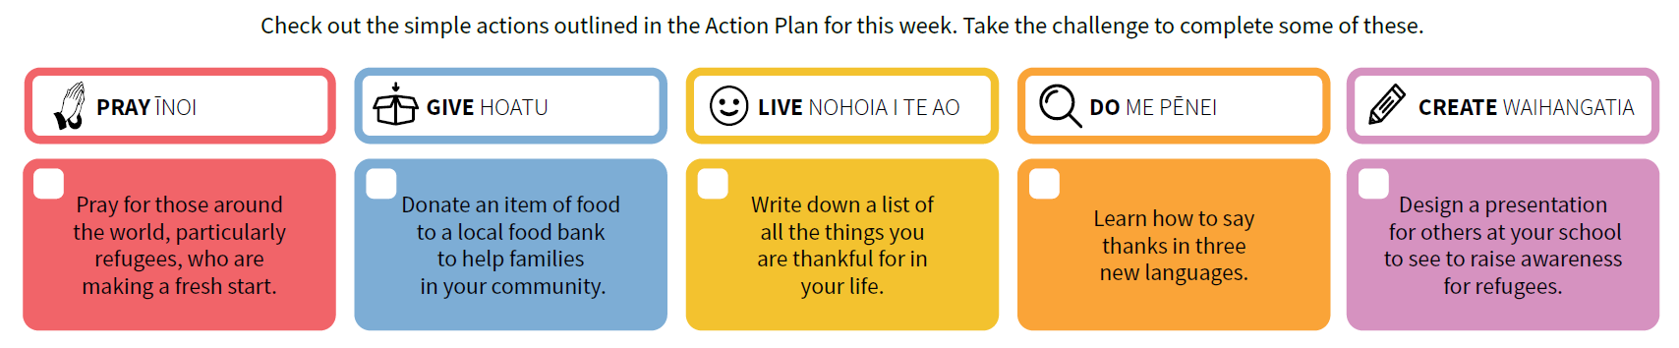



Slide 53

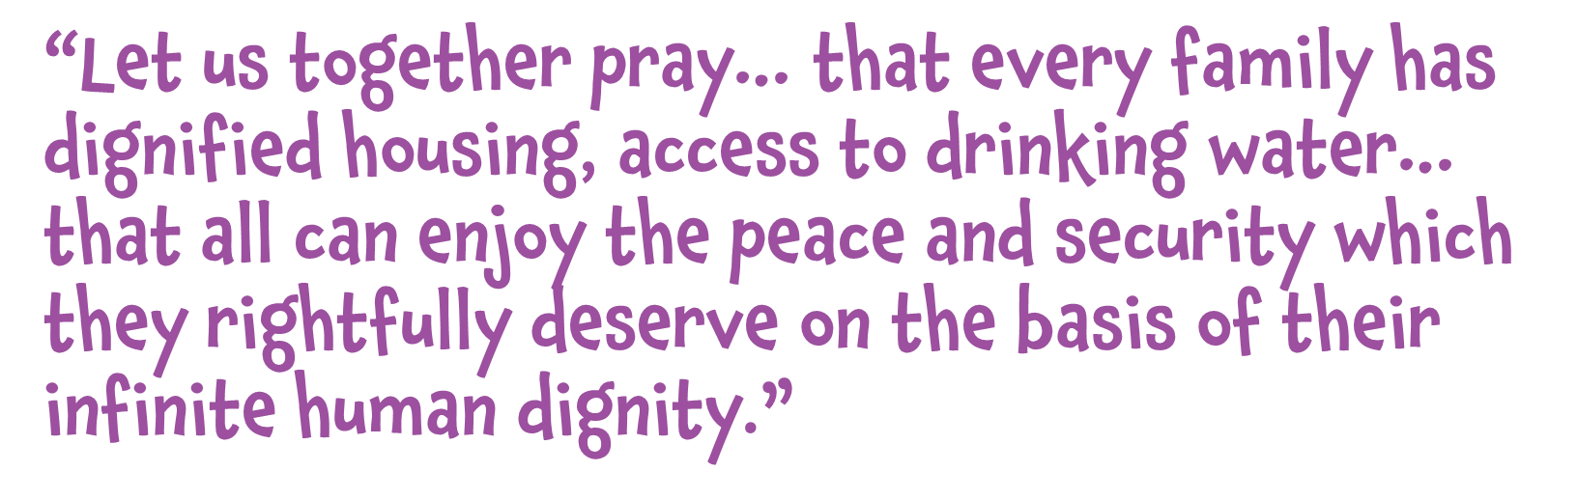
Notes:
Image credit: Flickr

Slide 54
E te Atua o te Aroha, God of Love,
Some people are capable of transforming difficult situations into something joyful with a simple smile. They seem to possess an inner light. They are channels of your love in the world. Help us to be your instruments in the world, to bring joy through a simple smile and a helping hand. May we always be generous in sharing the aroha which you have given us.
Amene.

Slide 55


Life is a journey with many different pathways. Our choices determine where we go, who we meet, and ultimately where we end up. We all are given great opportunities at different points on our journey. It is important to firstly see these as opportunities and then to take them whenever we can.

Slide 56
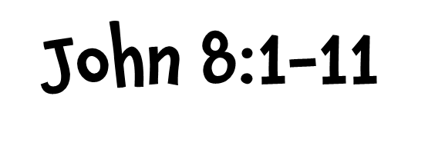
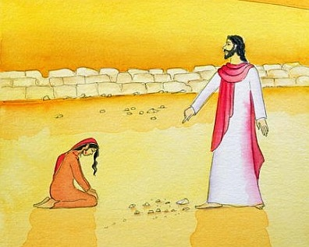
Read the full Gospel reading by clicking here
Summary:
• Jesus went to the Mount of Olives.
• As per usual, he went to the temple early in the morning.
• People came and he taught them.
• The scribes and the Pharisees caught a woman in adultery and brought her before the crowd and Jesus.
• They stated that the law of Moses commanded that the woman should be stoned to death.
• They asked Jesus what his response would be to test him so that they might have a charge to bring against him.
• Jesus said nothing but bent down and wrote his finger on the ground.
• They kept questioning him and so Jesus stood up and said “Let anyone among you who is without sin be the first to throw a stone at her.”
• He the continued to write on the ground.
• The crowd left, one by one, until Jesus was alone with the woman.
• Jesus asked the woman, “Has no one condemned you?”
• She affirmed this before Jesus told her, “Neither do I condemn you. Go your way, and from
now on do not sin again.”
Notes:
Image Credit: art-prints-on-demand.com

Slide 57


In Timor-Leste, 80% of women are not paid for their work. Caritas supports a women’s group called HAFOTI that enables Timorese women to rise above their circumstances, and have greater confidence and enhanced dignity as family leaders and community participants.
By using a co-operative business model, HAFOTI members run micro-enterprises. Women have great opportunities to develop their individual skills in remote locations, gain access to resources, and earn an income for their families. HAFOTI empowers many of its members to ultimately progress into leadership and mentoring roles.

Slide 58
HAFOTI members live all across the country in 8 main regions.
The pandemic has provided lots of challenges for HAFOTI.

Slide 59
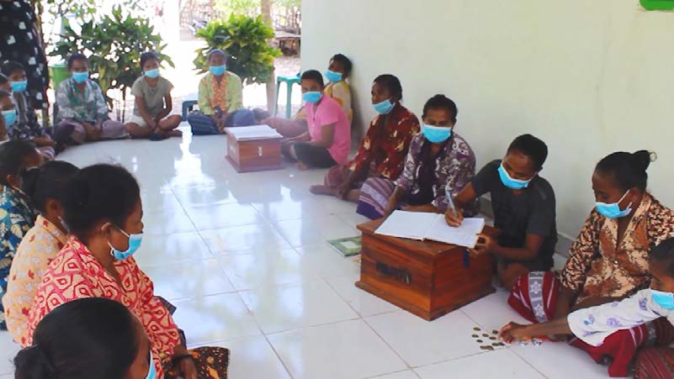
Meetings are important within the local groups for training, direction and finance.

Slide 60
It takes a lot of hard work to produce the products.
Watch the HAFOTI in Timor-Leste video to see the members in action

Slide 61
Finding new opportunities for selling products is important.
The HAFOTI shop in Dili showcases all the amazing local products which are eventually sold.

Slide 62
In the Gospel reading the woman caught doing wrong does not have too many supporters and may have been killed if Jesus had not been in the temple. Jesus disarms the crowd and points out that only those who are perfect should do the judging. No-one met this description except Jesus himself. Yet he was quick to forgive and return the woman’s dignity by giving her another opportunity and a reminder to change her ways.
Like Jesus, HAFOTI restores the dignity of women in Timor-Leste providing them with great opportunities. Many of the women have faced tough challenges in their lives and their connection to HAFOTI provides direction and hope for their future.

Slide 63
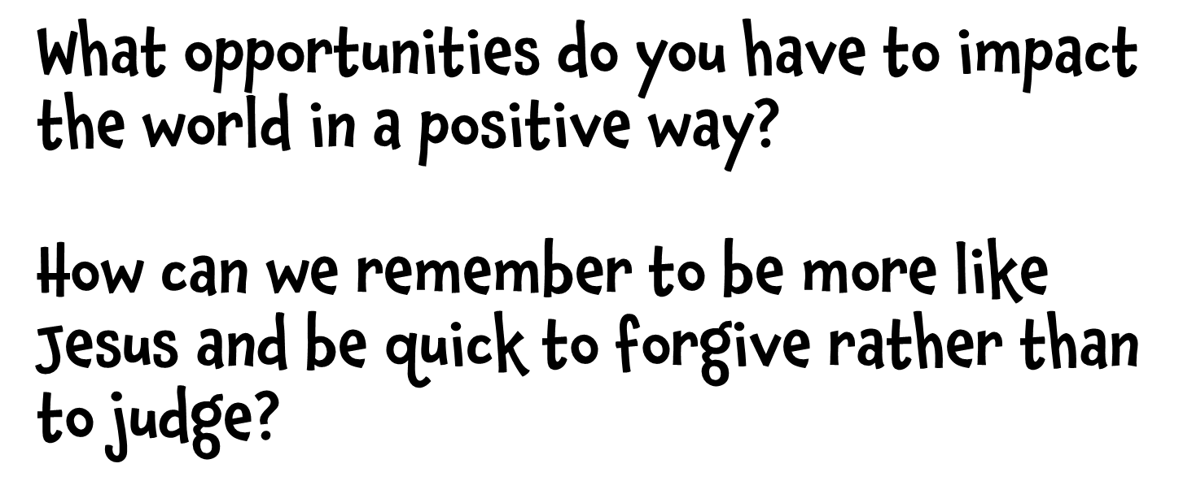

Slide 64

The people of Timor have a lovely story that tells the tale of a boy and his friend the crocodile. It is a legend about how the land came to look like it does. It is also a good story about kindness and friendship.
Watch a video of The Boy and the Crocodile being read aloud.
Discuss what we can learn form the story and how it relates to our Lenten goals.

Slide 65

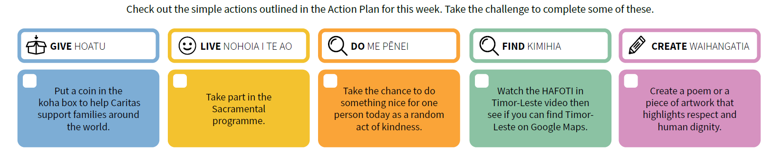

Notes:
Image Credit: teacupsandtales.co.uk

Slide 66

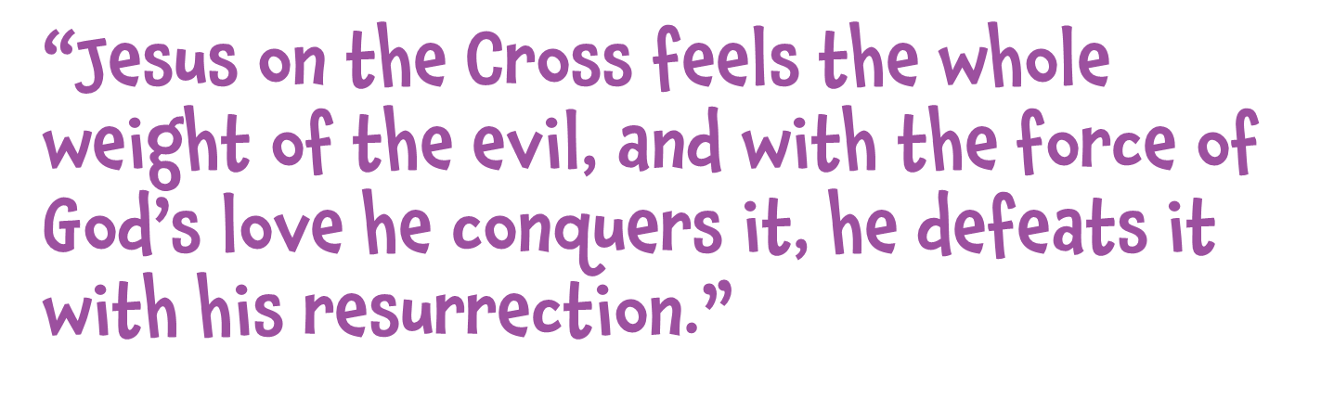
Notes:
Image credit: Flickr

Slide 67

E te Atua o te whakaaroha, God of mercy, we thank you for the sacrifice of your Son, our Saviour, Jesus Christ. Help us to be compassionate and merciful as you are compassionate and merciful. Help us to see how we might show compassion to those most in need. We make our prayer through Christ our Lord.
Amene.

Slide 68

Holy Week is the culmination of Lent, as we remember the sacrifice of Christ on the cross. The manner of Jesus’ death is unjust and horrific but it is the reality of the resurrection that brings hope, peace and life anew. Jesus, as the ultimate peacemaker, gave us the greatest gift of all – overcoming sin and death.

Slide 69

Read the full Gospel reading by clicking here
Summary:
• At the place called The Skull, Jesus is crucified along with two criminals.
• Jesus says, “Father, forgive them; for they do not know what they are doing.”
• The soldiers cast lots to divide his clothing while the crowd watch.
• Leaders and soldiers challenge Jesus to save himself if he is indeed the Messiah.
• An inscription was placed over him saying, ‘This is the King of the Jews.’
• One of the criminals yelled at Jesus and said, “Are you not the Messiah? Save yourself and us!”
• The other criminal rebuked him and reminded him that they were getting what they deserved
for what they had done, but Jesus had done nothing wrong.
• He then asked Jesus to remember him when Jesus came into his kingdom.
• Jesus replied, “Truly I tell you, today you will be with me in Paradise.”
• Darkness then came over the land from midday to three in the afternoon.
• The curtain of the temple was torn in two and Jesus cried out with his last breath, “Father, into
your hands I commend my spirit.”
• The centurion seeing this firsthand knew that Jesus was innocent and praised God.
• The crowds that had gathered returned home beating their breasts.
• Jesus’ friends, including the women from Galilee, stood watching at a distance.

Slide 70

Holy Week provides the perfect opportunity for following the Stations of the Cross to remember Jesus’ journey to the cross.
There are many ways this activity can be organised. The Caritas slides are designed to help large groups or small groups follow the stations together one after the other from the same location. These slides can also be printed and left in different locations for students to move between if that is more helpful.

Slide 71
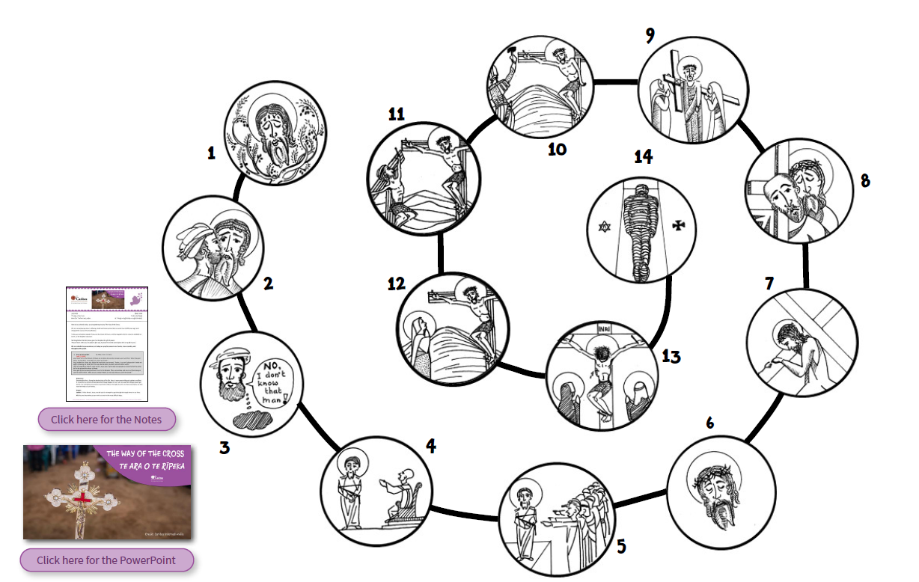
In the lead up to the events of Holy Week, take time together using The Way of the Cross to remember what Jesus experienced two thousand years ago to transform the world as the ultimate peacemaker. You will find the relevant Scriptures for each station as well as a relevant reflection connecting to various places around the world based on recent events.

Slide 72
As Jesus hung on the cross, he didn’t cry out at the injustice of it all. He didn’t cry out at the pain he was feeling. Instead he talked to God and was focused on forgiving those who had caused his suffering.
As Pope Francis points out, Jesus ‘feels the whole weight of evil’ yet he conquers it ‘with the force of God’s love’. He is indeed the greatest gift of all, the one who transforms our relationship with God for all eternity.
There are many observers at Jesus’ crucifixion. It is interesting to reflect on who we most resemble...
Jesus’ friends – sad and shocked watching at a distance;
others in the crowd – angered at the injustice they saw;
the centurion – whose life was amazingly changed by Jesus;
the guards – who laughed and mocked Jesus;
the criminals – who joined in Jesus’ pain.
Even though we’ve heard the story of Jesus’ crucifixion many times, let’s stop and reflect on the impact for us personally.

Slide 73
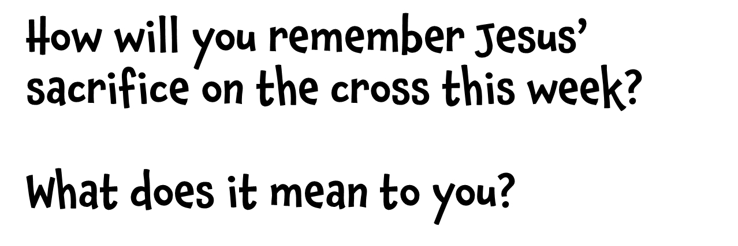

Slide 74

Reflect on the goals that you may have set at the beginning of the Lenten period.
Did you manage to achieve these? What could you continue doing beyond Lent?
In what ways can you be a peacemaker? How can you help build dreams with others to make a difference in the world?
What are the most important things that you have learnt during Lent?
How can you remember these things and learn from them in the future?
Notes:
Image Credit: PxHere

Slide 75
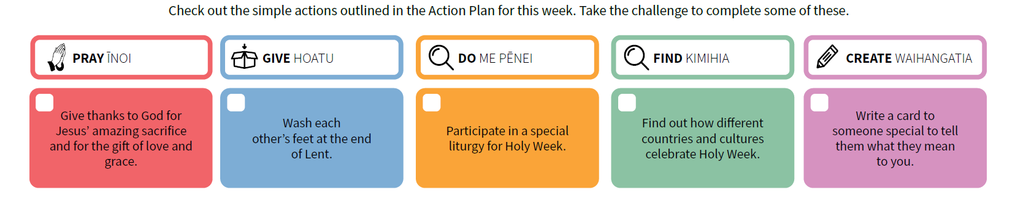
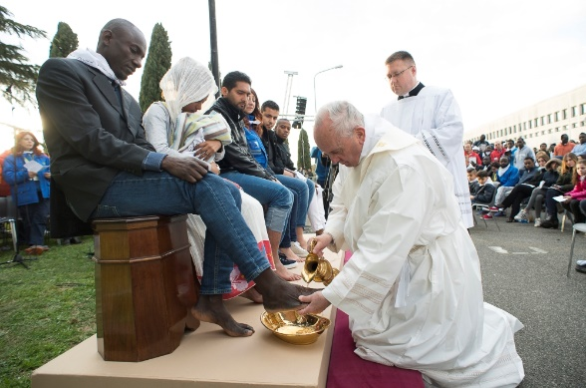
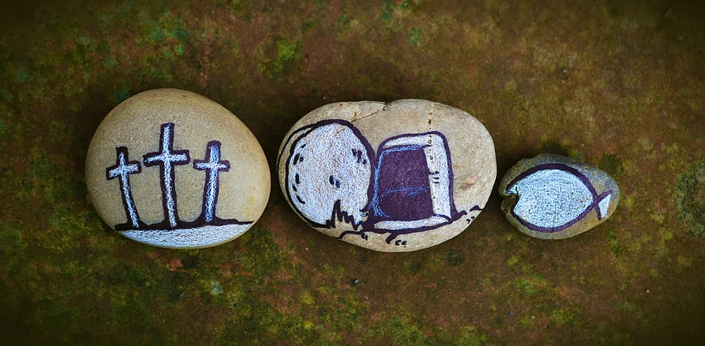
Notes:
Image Credit: CNS/L'Osservatore Romano

Slide 76


